Slide 1


Order and Shipping Analytics
PRESENTATION
Order and Shipping Analytics using Advance SQL

Slide 2

OUR
AGENDA
Type of transaction with higher orders
Top 3 customers
Departments with highest orders i.e min 40+ orders
State with highest order cancellation %.

Slide 3
Number of orders based on type of transaction
/ * Get the number of orders by the Type of Transaction. Please exclude orders shipped from Sangli and Srinagar. Also, exclude the SUSPECTED_FRAUD cases based on the Order Status. Sort the result in the descending order based on the number of order. */
TYPE | Numbers of Orders
DEBIT | 799
TRANSFER | 532
PAYMENT | 488
CASH | 259

Slide 4
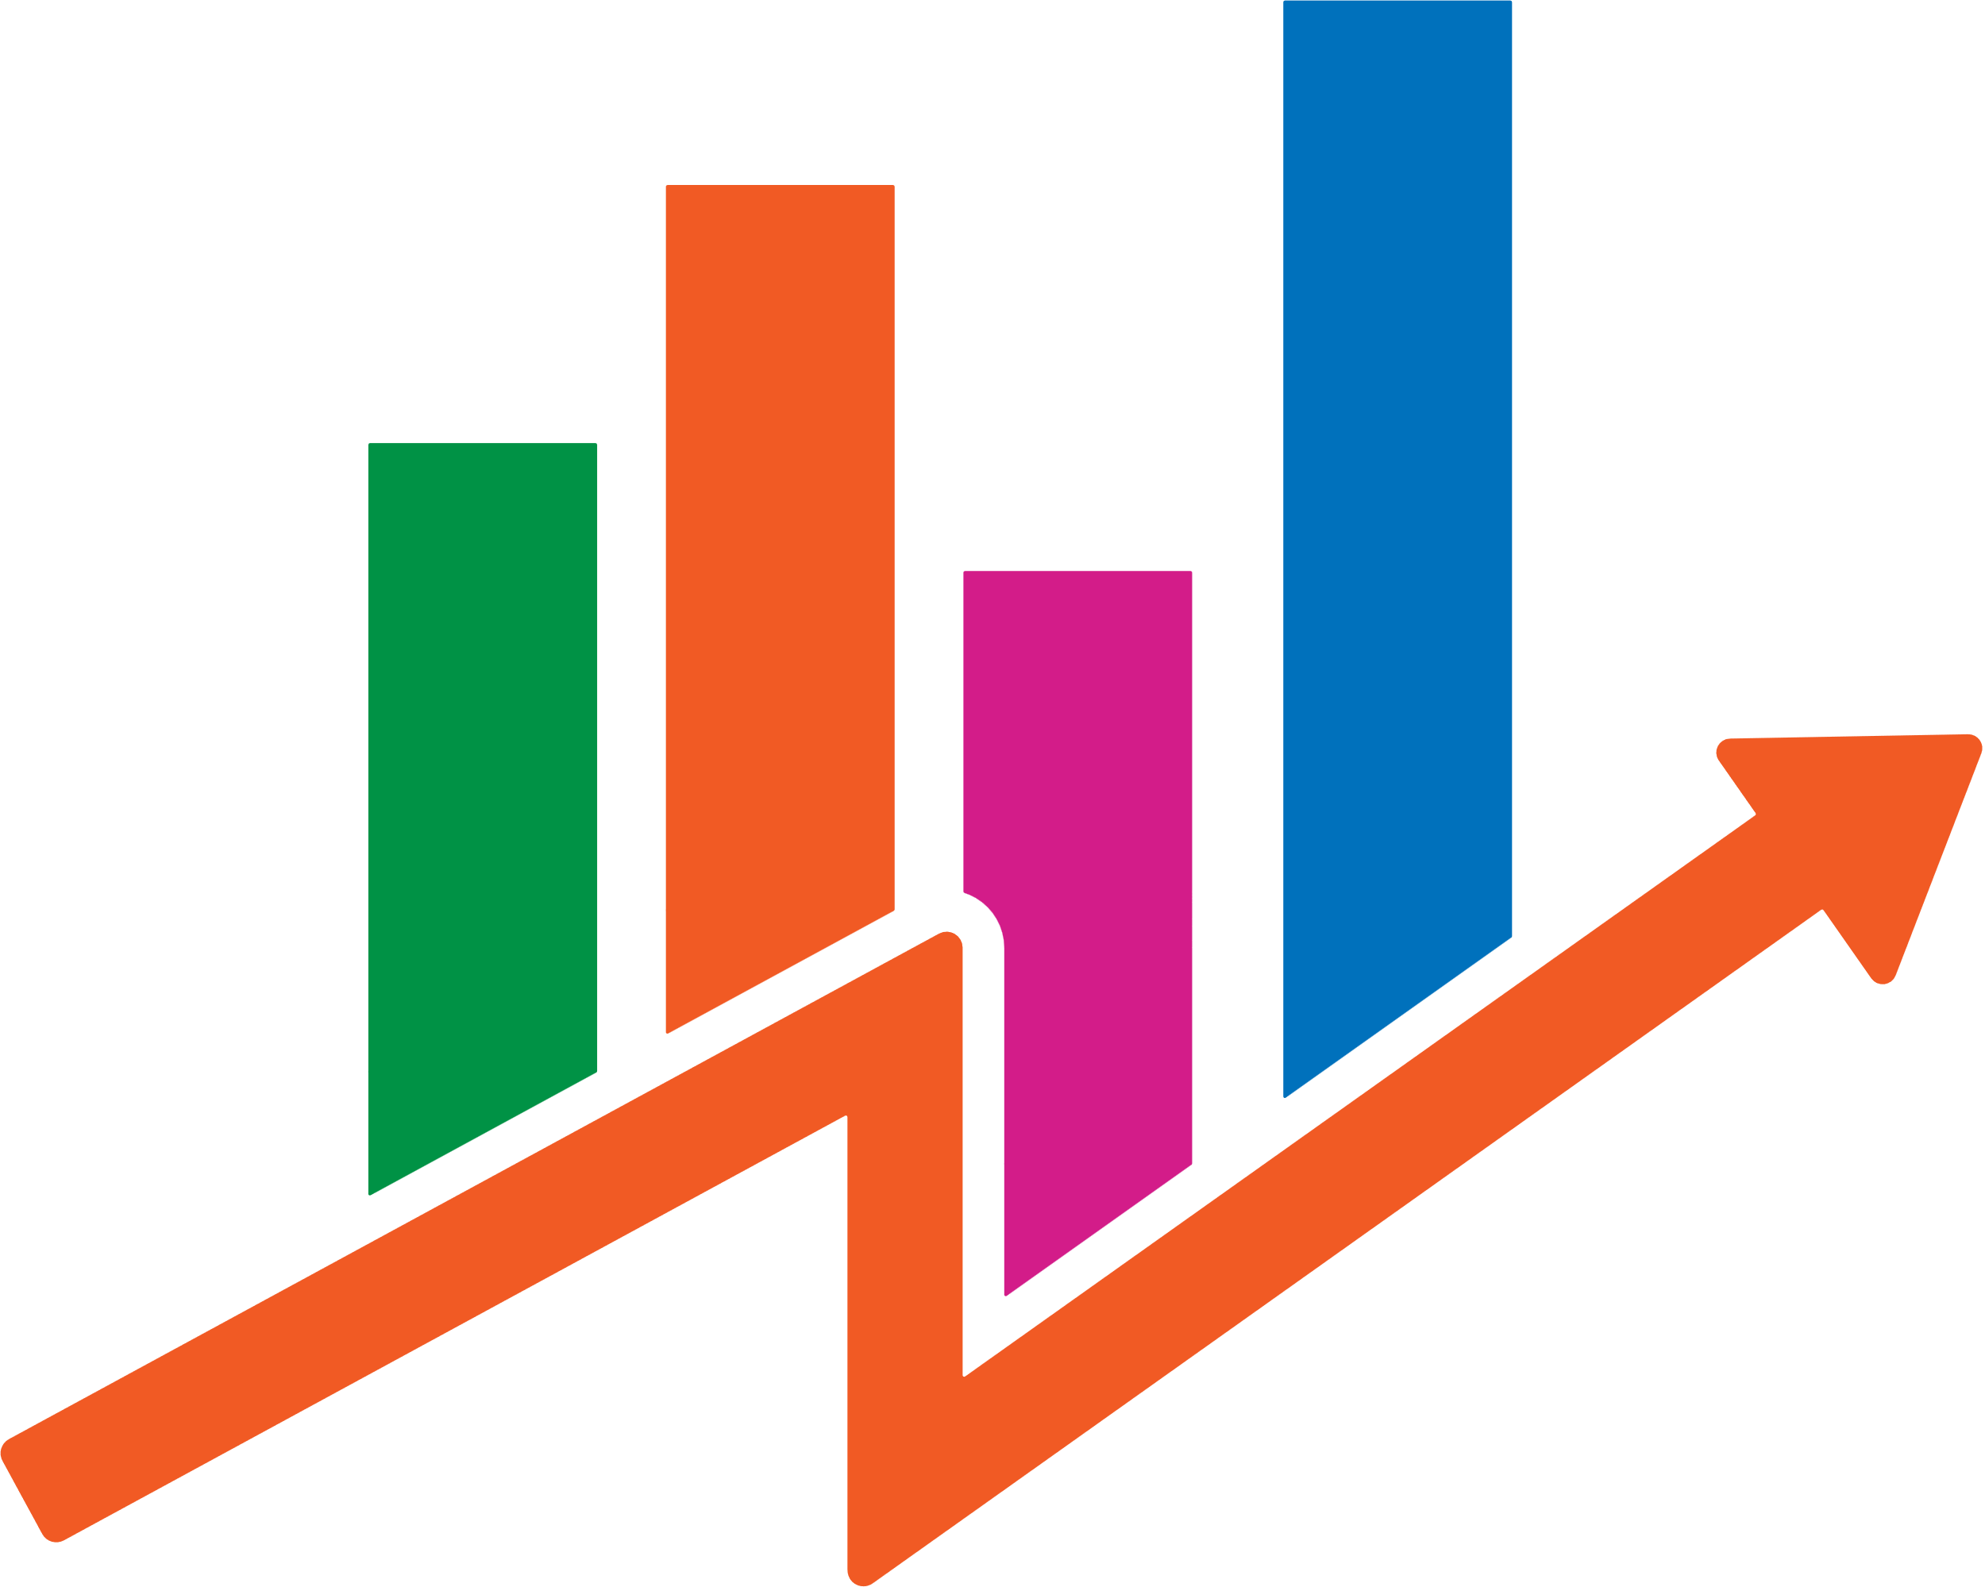
ANALYSIS
We can see that from ‘DEBIT’ transaction has the highest numbers of orders
This shows that most of the customers prefer online payments, so we should give offers for Debit transaction.
Use marketing strategy

Slide 5
Top 3 Customers
Get the list of the Top 3 customers based on the completed orders along with the following details:
Customer Id
Customer First Name
Customer City
Customer State
Number of completed orders
Total Sales
ID | FIRST_NAME | CITY | STATE | NO. OF COMPLETED ORDS | TOTAL_SALES
3465 | Mary | Santa Clara | CA | 10 | 2929.74
5612 | Mary | Caguas | PR | 10 | 2188.82
9106 | Mary | Waukegan | il | 7 | 119.83

Slide 6
ANALYSIS
To know our valuable or loyal customers.
And can focus on maintaining their loyalty through personalized marketing, promotions, or loyalty programs.
Also can get the regions of highest orders, so we target that regions for increasing the sales/revenue

Slide 7
Departments with highest orders i.e min 40+ orders
Get the order count by the Shipping Mode and the Department Name.
Consider departments with at least 40 closed/completed orders.
SHIPPING MODE | DEPARTMENT | NO. OF ORDERS
Standard Class | Fan shop | 233
Standard Class | Apparel | 224
Standard Class | Golf | 147
Second Class | Apparel | 106
Second Class | Fan shop | 104

Slide 8

ANALYSIS
‘FAN SHOP’ and ‘APPAREL’ are 2 departments with higher orders.
i.e customers are intersected increase the marketing, stocks, customer retention of this departments.
We need to have fast shipping options readily available for such high-demand products.
Need to work on shipping strategy.

Slide 9
State with highest order cancellation %.
An order is cancelled when the status of the order is either cancelled or SUSPECTED_FRAUD. Obtain the list of states by the order cancellation % and sort them in the descending order of the cancellation %
Definition: Cancellation % = Cancelled order / Total Orders
ORDER STATE | CANCELLED ORDERS | TOTAL ORDERS | CANCELLATION %
Manipur | 1 | 9 | 11.1111
Haryana | 5 | 55 | 9.0909
Punjab | 5 | 55 | 9.0909

Slide 10
ANALYSIS
States with large numbers of cancel orders
Need to improve the supply chain of this region
High cancellation of orders might be linked to delivery delays, stockout or poor customer service.
Strategies to reduce the order cancellation by customer retention

Slide 11
CONCLUSION
Debit is the highest mode of transaction and CASH is the lowest.
Got top 3 customers from Santa Clara, Caguas and Waukegan city.
‘FAN SHOP’ and ‘APPAREL’ are 2 departments with higher orders.
General mode of shipping are ‘Standard ’ and ‘Second’ class.
Manipur, Haryana, Punjab are the state which has highest % of Order cancellation.

Slide 12

THANK YOU

